Slide 1

Capstone: Funnels with Warby Parker
Learn SQL from Scratch
Daniel Koechlein
July 15, 2018

Slide 2
Example Table of Contents
Get familiar with Warby Parker
What is the Quiz Funnel
A/B Testing with Home Try-On Funnel
Purchase Details
Actionable Insights

Slide 3
1.1 Quiz Funnel: Get Familiar
To help users find their perfect frame, Warby Parker has a Style Quiz that has the following questions:
"What are you looking for?”, "What's your fit?”, "Which shapes do you like?”, "Which colors do you like?”, "When was your last eye exam?”
The users' responses are stored in a table called survey.
Select all columns from the first 10 rows. What columns does the table have?
SELECT *
FROM survey
LIMIT 10;
Column Name | Data type
question | TEXT
user_id | TEXT
response | TEXT

Slide 4
2-3.1 Quiz Funnel: Drop-off Points
Users will "give up" at different points in the survey. Let's analyze how many users move from Question 1 to Question 2, etc.
A total of 270 users complete the survey, from a total of 500
Users are most likely to drop off at Q3 and Q5. Users may be dropping off at these points because they are unsure which shapes they prefer (Q3) and don’t know when their last
SELECT question, COUNT(DISTINCT user_id)
FROM survey
GROUP BY 1
ORDER BY 1;
Question | Count | Each step completion | Total
1. What are you looking for? | 500
2. What's your fit? | 475 | 95% | 95%
3. Which shapes do you like? | 380 | 80% | 76%
4. Which colors do you like? | 361 | 95% | 72%
5. When was your last eye exam? | 270 | 75% | 54%

Slide 5
4.1 Get familiar with Warby Parker: Home Try-On Funnel
Examine the first five rows of each table
What are the column names?
Home Try-On Column Names | Data type
user_id | TEXT
number_of_pairs | TEXT
address | TEXT
SELECT *
FROM quiz
LIMIT 5;
SELECT *
FROM home_try_on
LIMIT 5;
SELECT *
FROM purchase
LIMIT 5;
Purchase Column Names | Data type
user_id | TEXT
product_id | INTEGER
style | TEXT
model_name | TEXT
color | TEXT
price | INTEGER
user_id | TEXT
Quiz Column Names | Data type
user_id | TEXT
style | TEXT
fit | TEXT
shape | TEXT
color | TEXT

Slide 6
4.2 Home Try-On Funnel: A/B Testing
The number of pairs tried on does not make a significant different whether users made a purchase or not. I was surprised by this finding so I checked my work to make sure there was no major different in the purchase amount, and that confirmed this finding
SELECT h.number_of_pairs AS 'pairs_tried_on',
COUNT(p.user_id IS NOT NULL) AS 'total_purchases'
FROM home_try_on AS 'h'
LEFT JOIN purchase AS 'p'
ON h.user_id = p.user_id
GROUP BY h.number_of_pairs;
SELECT h.number_of_pairs AS 'pairs_tried_on',
ROUND(AVG(p.price), 2) AS 'average_purchase_price'
FROM quiz AS 'q'
LEFT JOIN home_try_on AS 'h'
ON q.user_id = h.user_id
LEFT JOIN purchase AS 'p'
ON q.user_id = p.user_id
WHERE h.number_of_pairs IS NOT NULL
GROUP BY 1;
pairs_tried_on | total_purchases
3 pairs | 379
5 pairs | 371
pairs_tried_on | average_purchase_price
3 pairs | 113.26
5 pairs | 112.35

Slide 7
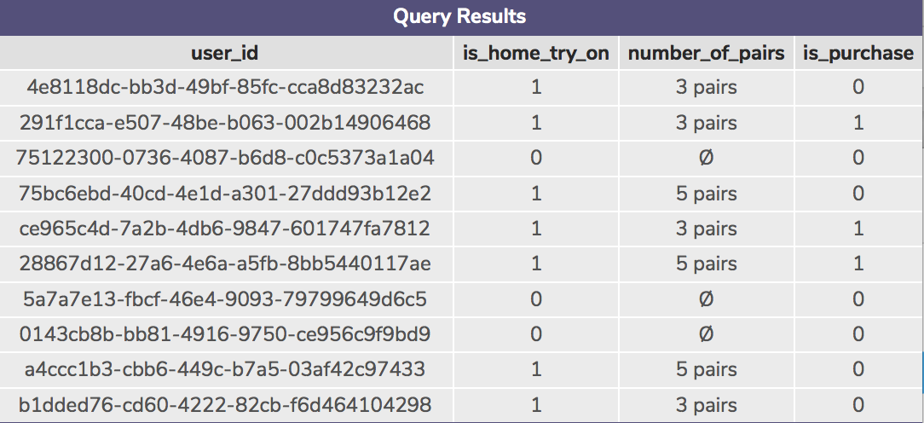
5.1 Home Try-On Funnel: New Table (Left Join)
The number of pairs tried on does not make a significant different whether users made a purchase or not
SELECT DISTINCT q.user_id,
h.user_id IS NOT NULL AS 'is_home_try_on',
h.number_of_pairs,
p.user_id IS NOT NULL AS 'is_purchase'
FROM quiz AS 'q'
LEFT JOIN home_try_on AS 'h'
ON q.user_id = h.user_id
LEFT JOIN purchase AS 'p'
ON q.user_id = p.user_id
LIMIT 10;

Slide 8
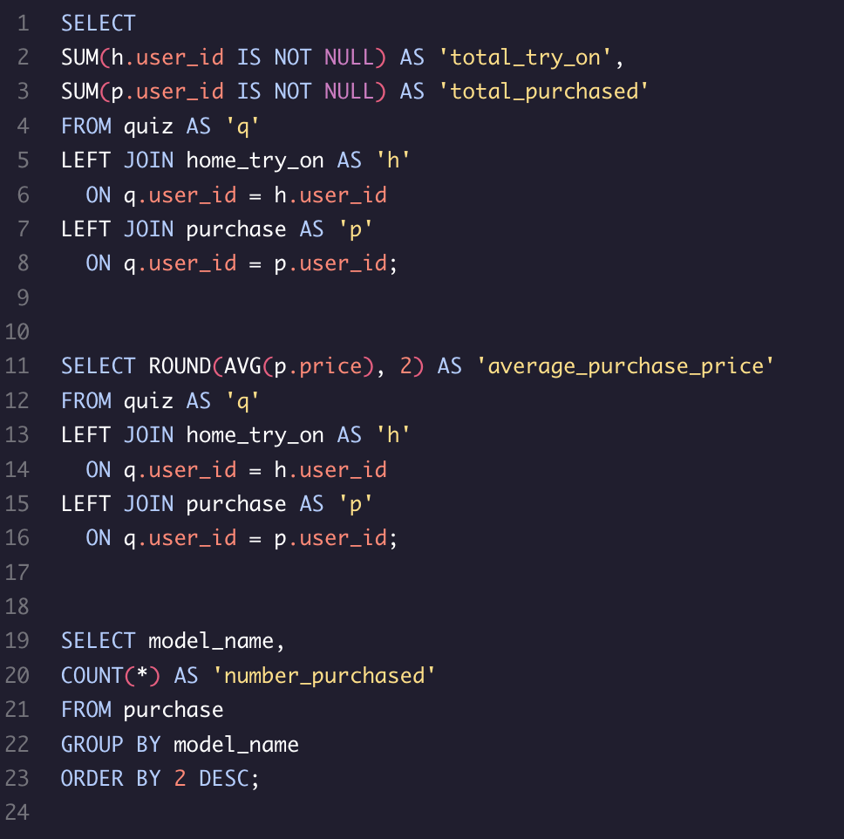
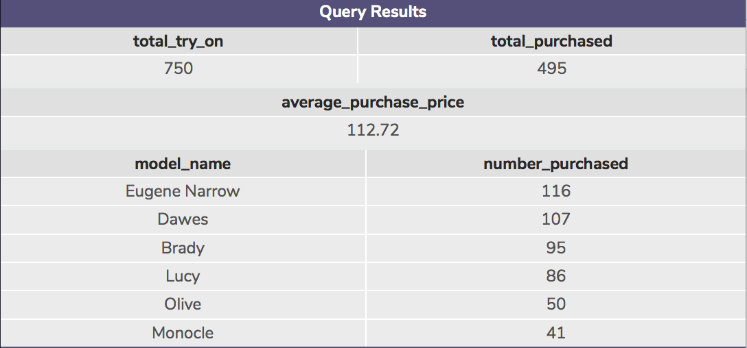
6.1 Purchase Journey and Details
Compare conversion from quiz → home_try_on and home_try_on --> purchase. 66% of home try-ons made a purchase.
Average purchase amount. Average purchase price was $112.72
Most popular frame types. Eugene Narrow and Dawes are the most popular models. Monocle and Olive are the least popular

Slide 9
7. Insights
Low quiz completion at two points the quiz funnel. First issue is when users are asked for their preferred shape. This may be an area users are struggling to answer for themselves, suggest including questions to help users figure this out. Second issue is most recent eye exam, suggesting that some users may need a new eye exam. Warby Parker can provide information at this point about where to get an exam to help potential customers.
Warby Parker should be flexible with the number of frames users are able to try on since there doesn’t appear to be a clear relationship between pairs trained on and purchase. Consider experimenting with higher amounts to see if this increases purchase rate. Alternatively, this may suggest that trying on more frames does not improve purchase rates. If shipping 5 frames has a higher cost than 3 frames, consider lowering the number of frames available for try-on in order to reduce shipping costs with minimal impact on purchase rates.
There is big variation in the purchase of different frame models, marketing or promotions may be considered for the less popular frames.

